Slide 1

FPGA Farm and Infrastructure
Progress Update: DE-10 Agilex 7 & AI Deployment
By: Samip Bhattarai
15/06/2026

Slide 2
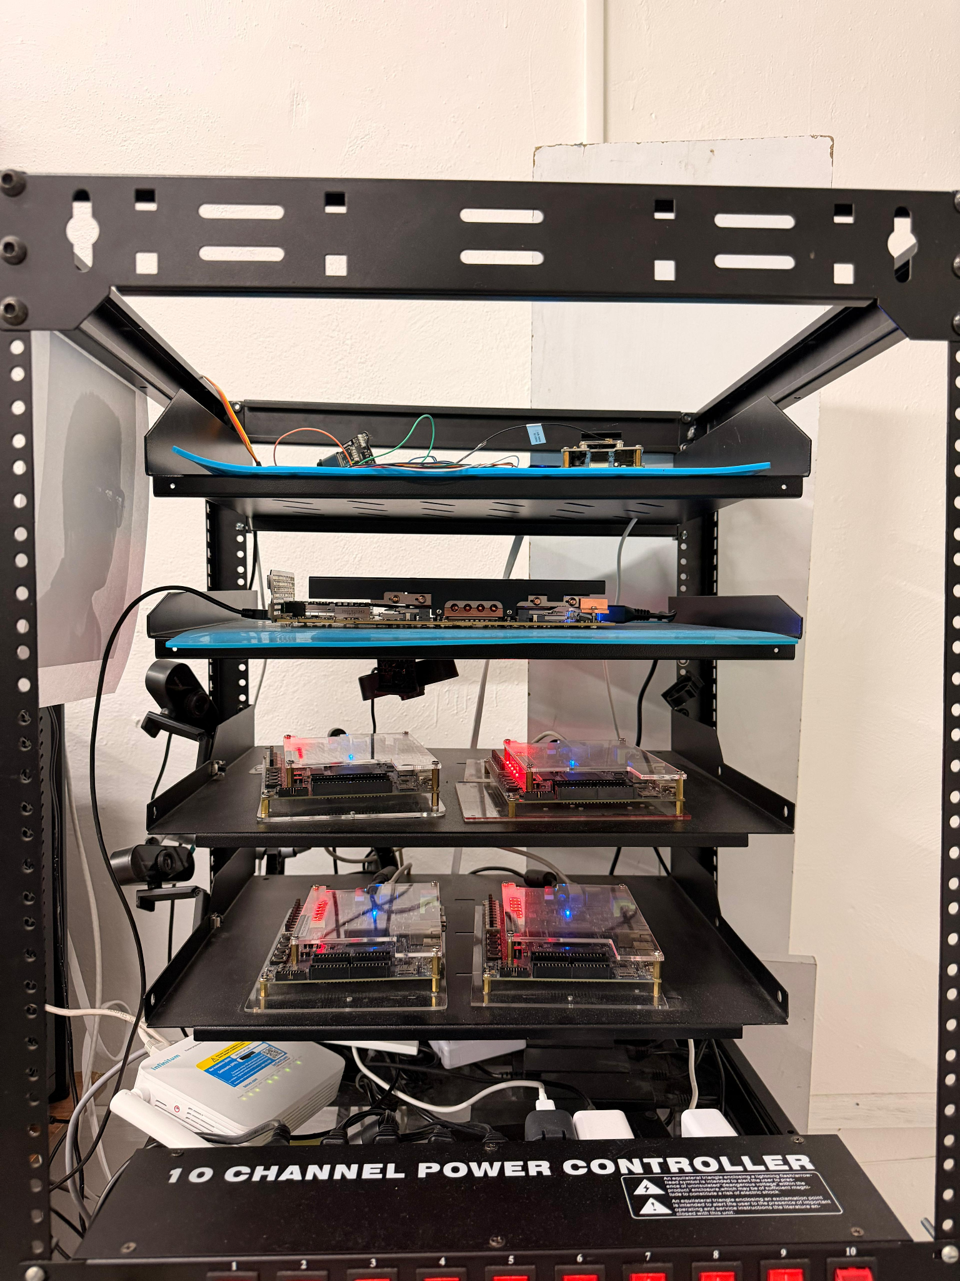
Planned Objectives
Installation: Physically Installing the Agilex 7 Board on the FPGA Farm.
API Development: Add functionality to analyze a given task, manage board states and control board power.
Testing: Benchmarking AI models as a routing agent on the FPGA Farm accounting for edge cases.

Slide 3






Agilex 7 Setup Challenge
Strict I/O & Voltage
SDM & PMBus
Solution
Agilex DE-10 requires highly specific I/O standards compared to older Quatus boards.
Secure Device Manager (SDM) requires explicit Voltage Identification (VID).
Altera’s SystemBuilder auto-generates necessary VID assignments to satisfy SDM requirements

Slide 4
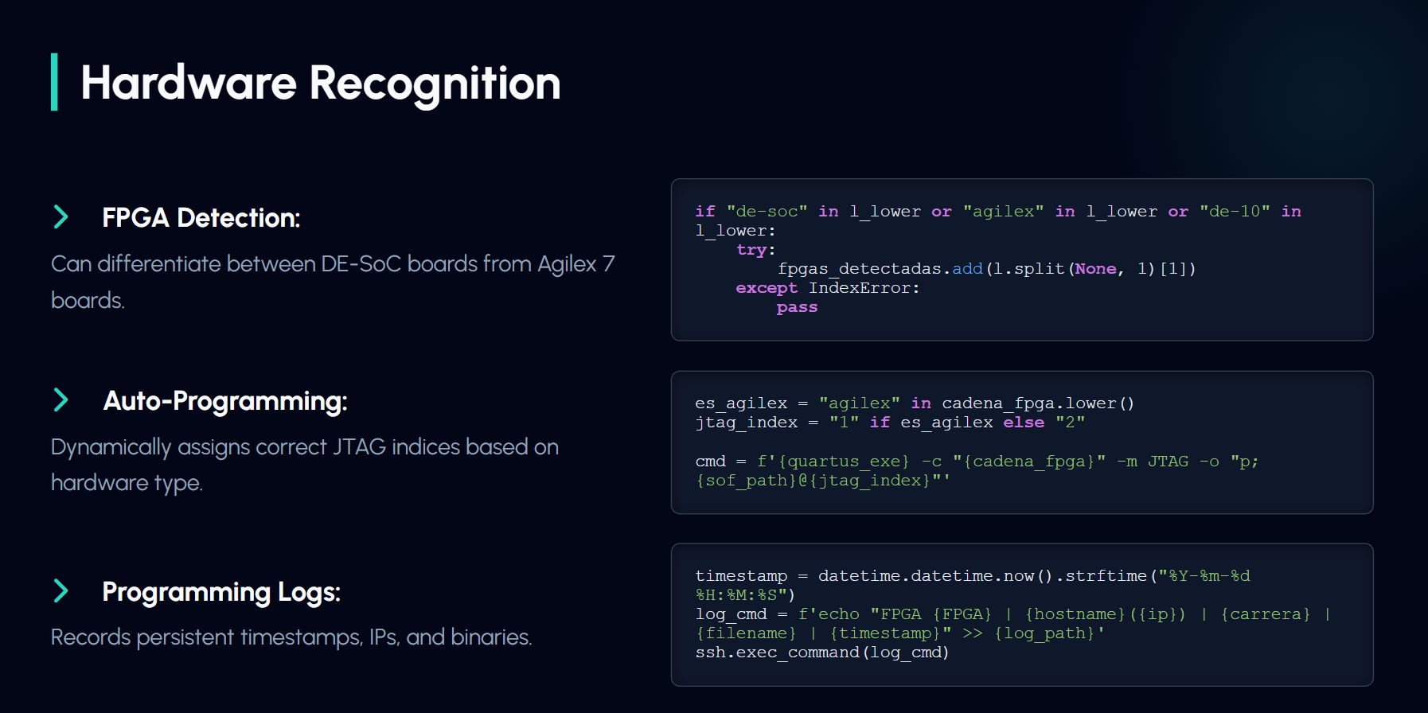
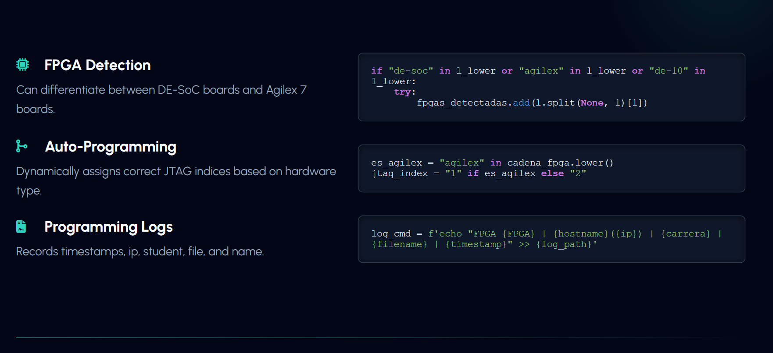
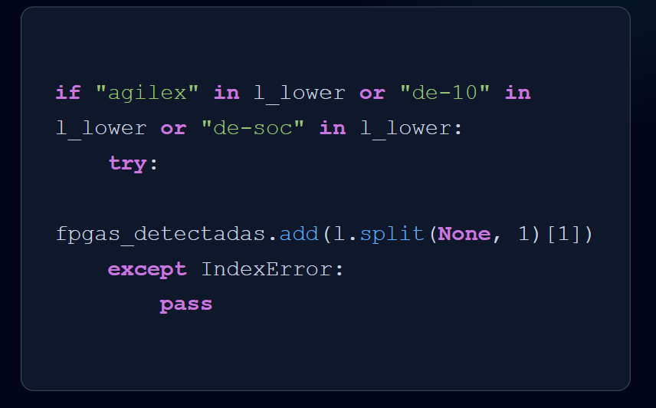
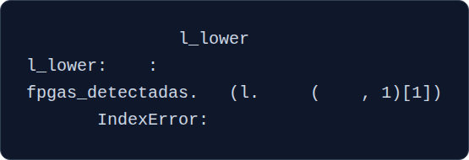
Hardware Recognition
FPGA Detection: Can differentiate between DE-SoC boards from Agilex 7 boards.
Auto-Programming:
if
"agilex"
in
or
"de-10"
in
try
add
split
None
Programming Logs:
except
pass

Slide 5
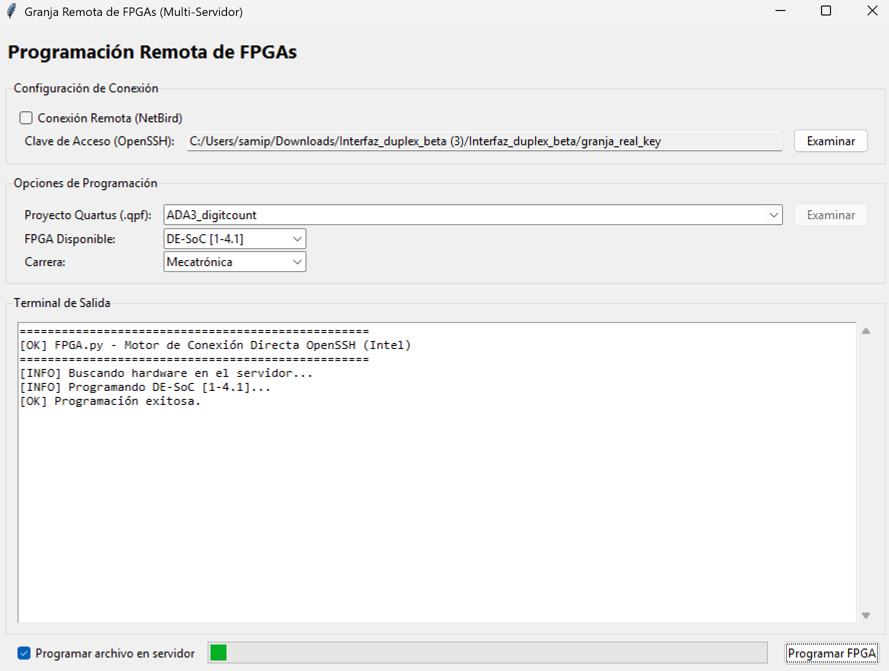
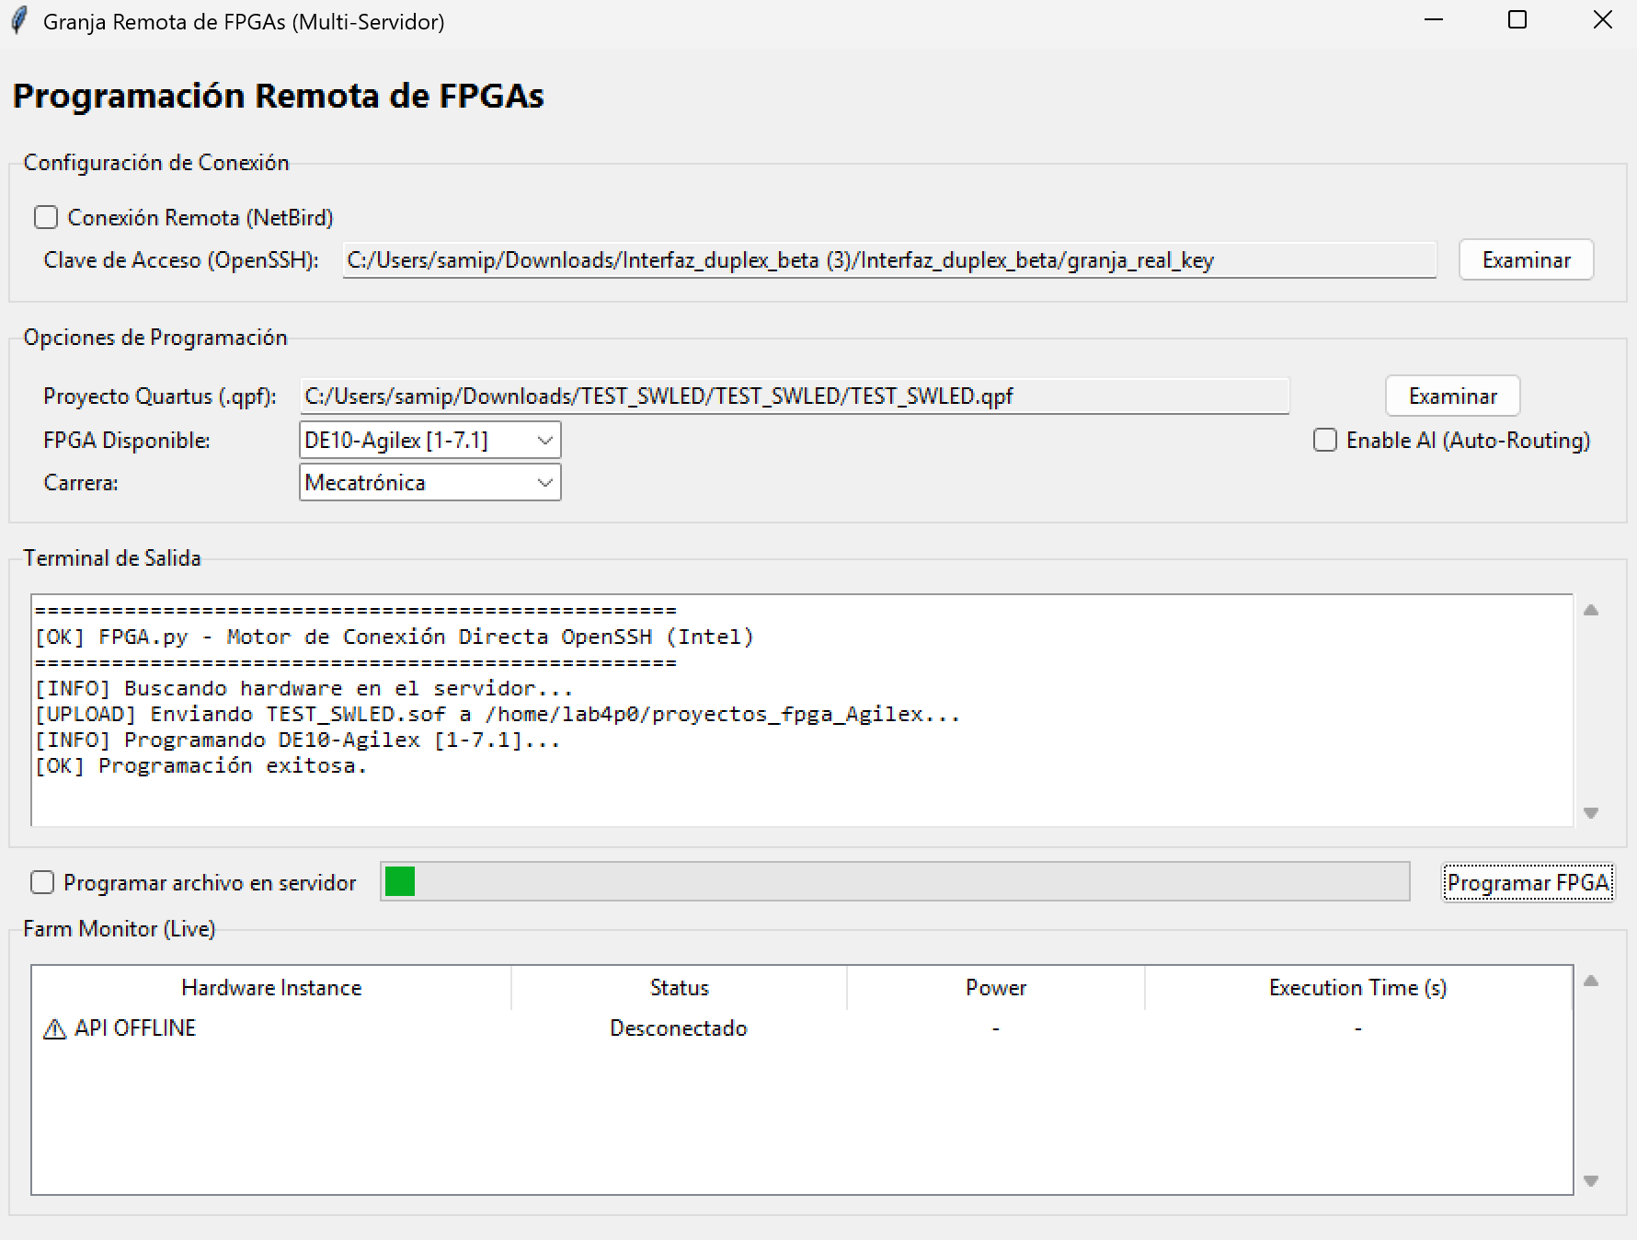
Programming Examples

Slide 6
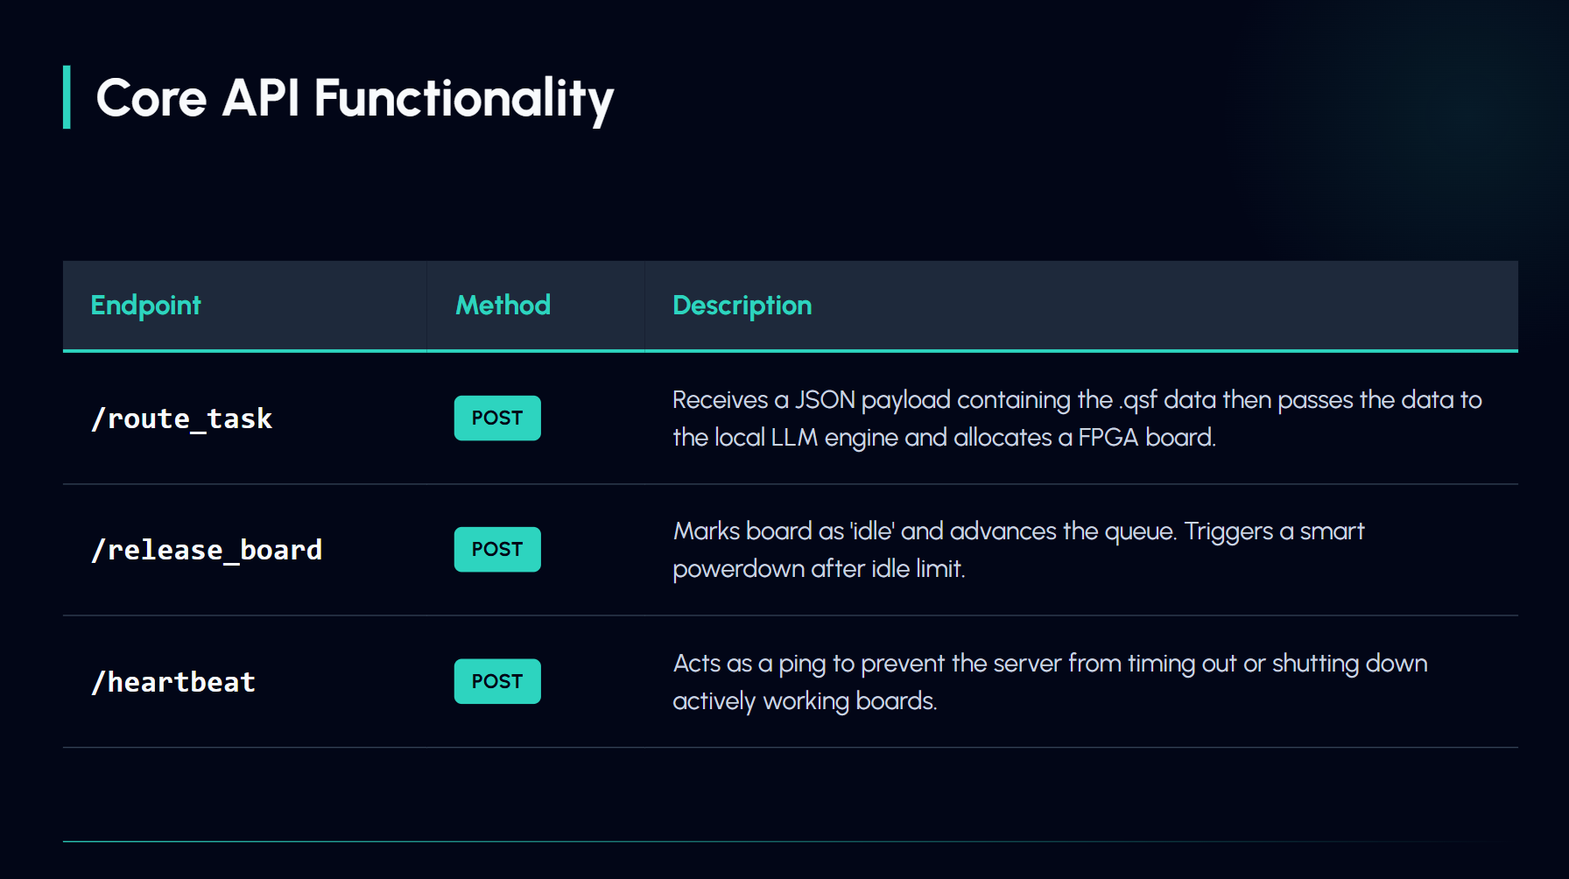





Core API Endpoints
Endpoint | Functionality
/route_task POST | Ingests telemetry. AI decides architecture (DE-SoC vs Agilex). Allocates & powers board.
/release_board POST | Marks board as 'idle'. Advances the internal queue. Triggers smart power-down.
/heartbeat POST | Keep-alive signal. Prevents background watchdog threads from forcefully timing out tasks.

Slide 7


AI Agent Testing
Model Type
Methodology
Reasoning Model: Form answers through Chain-of-Thought. Typically smarter however adds latency to responses.
General Purpose Model: From answers fast and don’t overthink. Keep latency minimal especially with tasks such as reading JSON files.
A python file generates synthetic .flow.rpt files for each family of FPGA Boards.
Invalid .flow.rpt files were also created to test edge cases for the Agent.
Built in answer validation by checking the family of the .flow.rpt.

Slide 8
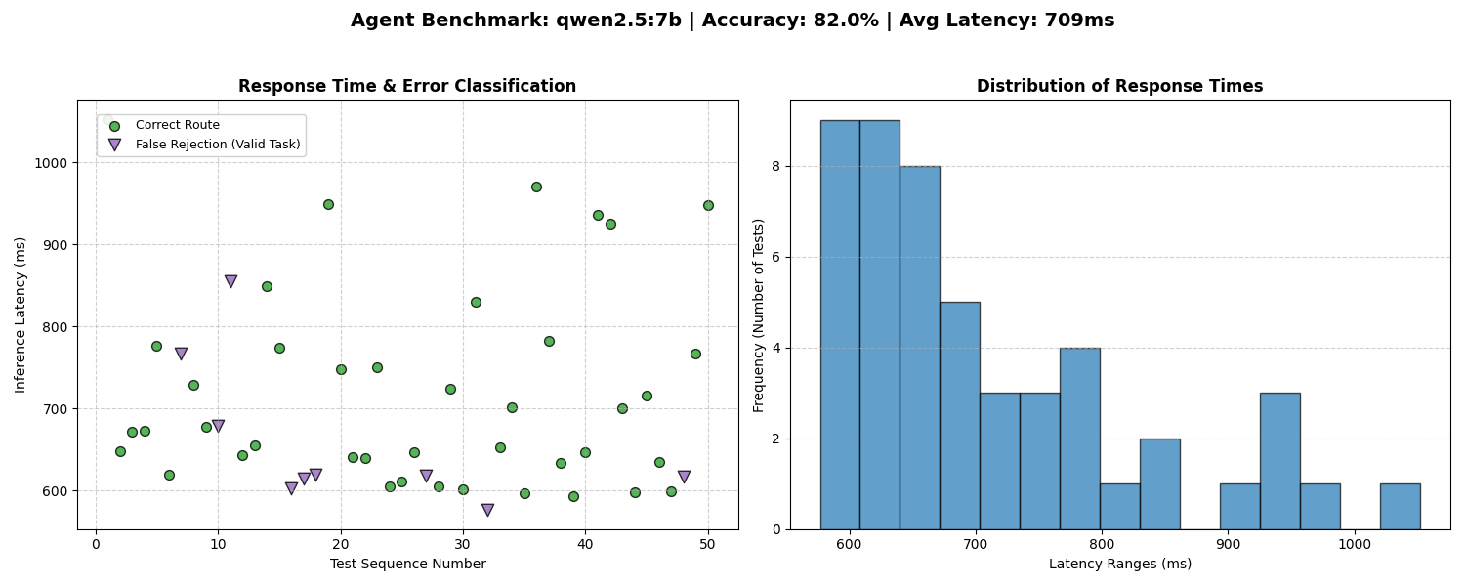
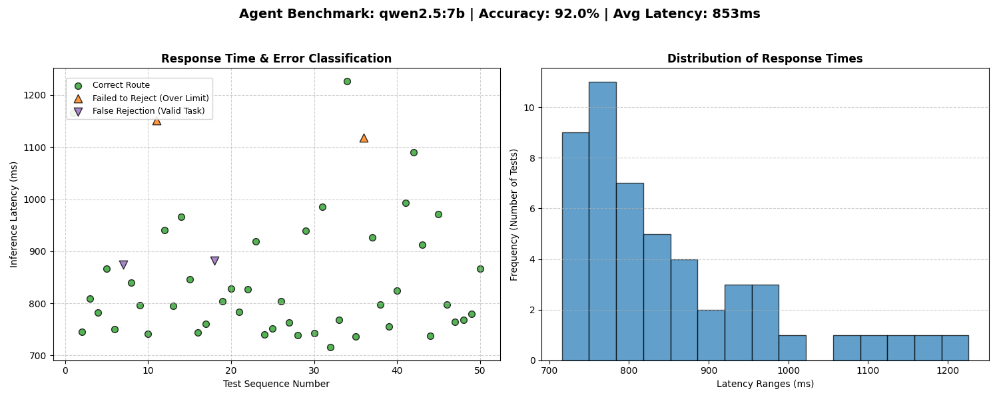
Evaluating LLM Routing Models
Prompt Engineering (Before)
Task given as a list
Only the capability of De-SoC board mentioned
Uninformed of FPGA boards other than Agilex or De-SoC
Edge Cases not mentioned
Prompt Engineering (After)
Task given as a step by step algorithm and forced to evaluate decisions step by step
Implemented strict limits of Agilex
Rules added for boards other than De-SoC or Agilex

Slide 9
Evaluating LLM Routing Models
LLM Model | Accuracy (%) | Average Response Time (ms)
DeepSeek R1: 8B (Deep Reasoning) | 100.0% | 26,537 ms (26.5 s)
Llama 3.1: 8B (General Purpose) | 96.0% | 906 ms (0.9 s)
Llama 3.1: 1B (Ultra Small) | 56.0% | 541 ms (0.5 s)
Qwen 2.5: 7B (General Purpose) | 92.0% | 853 ms (0.9 s)

Slide 10
Next 2 Weeks
Continue testing AI models and system prompts
Transfer the API onto the server
Develop a live dashboard
GUI Redesign
AI Recommendation System
Implement remote FPGA power through SMART WIFI PLUGS

Slide 11
Thank You!

